Slide 1
CSE 4101
Artificial Intelligence
Lecture 1
Instructor: Nayeema Islam

Slide 2
Class Schedule
Day | Class Time | Room No.
Sunday | 01.30-02.30 | 601
Thursday | 10.30-11:30 | 601

Slide 3

Reference Book
Elaine Rich, Kevin Knight McGraw-Hill, 1991 - 621 pages

Slide 4
Prerequisite
Strong Knowledge of Mathematics: Before getting started with AI, you must have sound knowledge of various mathematical concepts such as probability, statistics, algebra, matrix, calculus, etc. Mathematics is very important to build logical capability that is widely used in developing software and systems.
Good knowledge of Programming knowledge: To learn the fundamentals of writing codes, you must have sound knowledge of programming languages like Python, R, LISP, Java, C++, Prolog, etc.

Slide 5
Prerequisite
Strong Analytical skills: Analytical skills refer to the ability to think critically, analyze data, decision making capability as well as solve complex problems. These important skill sets involve taking in new information and mentally processing it in a productive manner. Hence, if you are planning to jump into the AI domain, you must build your analytical skills to a great extent.
Ability to understand complex algorithms: Artificial Intelligence is a field that completely depends on various algorithms that tell computers how to learn and take actions further.
Basic knowledge of Statistics and modelling: Statistical modelling is defined as the use of mathematical models and statistical assumptions to generate training data and predict outcomes for the future.

Slide 6
Evaluation
Marks for the course will be calculated as follows:
Category | Marks
Mid-Term Examination 1 | 10%
Mid-Term Examination 2 | 10%
Continuous performance | 10%
Final Exam | 70%
Total | 100%

Slide 7
Introduction to Artificial Intelligence
lecture 1

Slide 8
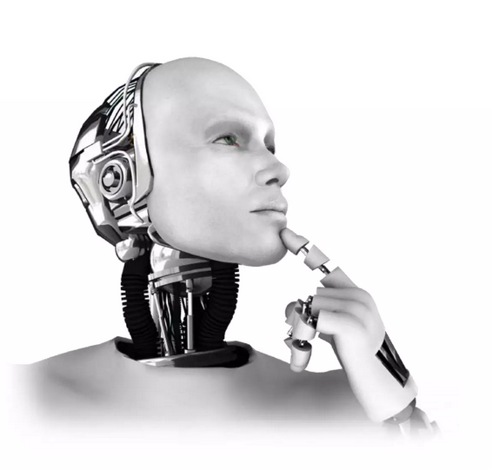
What is Artificial Intelligence
The study of computer system that attempts to model and apply the intelligence of the human mind,
A branch of computer science dealing with the simulation of intelligence behavior in computers,
The capability of a machine to imitate intelligent behavior,

Slide 9
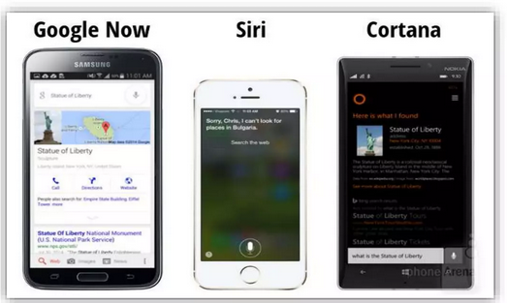
What is Artificial Intelligence
Google Now, Siri, and Cortana are all intelligent digital personal assistants on various platforms (iOS-mobile operating system developed by Apple) and Windows Mobile). In short, the help find useful information when we ask for it using our voice.
We can use them to make calls, send messages, set remainders , take notes , recognize music, find great restaurants, check your calendar and more.

Slide 10
Google Now
Google Now is a google search app on your iPhone and iPad.
Google Now is about giving you just the right information at just the right time. It can show you the day’s weather as you get dressed in the morning, or alert you that there’s heavy traffic between you and your butterfly-inducing date—so you’d better leave now! It can also share news updates on a story you’ve been following, remind you to leave for the airport so you can make your flight and much more. There’s no digging required: cards appear at the moment you need them most—and the more you use Google Now, the more you get out of it.

Slide 11
Siri
Siri is Apple's virtual assistant for iOS (iPhone Operating System), macOS (The computer operating system (OS) for Apple desktops and laptops), tvOS (the operating system that runs on the 4th and 5th generation Apple TV digital media player) and watchOS (the operating system of the Apple Watch,) devices that uses voice recognition and is powered by artificial intelligence (AI).
Siri responds to users' spoken questions by speaking back to them through the device's speaker and presenting relevant information on the home screen from certain apps, such as Web Search or Calendar. The service also lets users dictate emails and text messages, reads received emails and messages and performs a variety of other tasks.

Slide 12
Siri
Siri is Apple's virtual assistant for iOS (iPhone Operating System), macOS (The computer operating system (OS) for Apple desktops and laptops), tvOS (the operating system that runs on the 4th and 5th generation Apple TV digital media player) and watchOS (the operating system of the Apple Watch,) devices that uses voice recognition and is powered by artificial intelligence (AI).
Siri responds to users' spoken questions by speaking back to them through the device's speaker and presenting relevant information on the home screen from certain apps, such as Web Search or Calendar. The service also lets users dictate emails and text messages, reads received emails and messages and performs a variety of other tasks.

Slide 13
Cortana
Cortana is Microsoft’s personal productivity assistant that helps you save time and focus attention on what matters most.
To get started, select the Cortana icon on the taskbar. If you’re not sure what to say, try asking, "What can you do?"
Here are some things Cortana can do for you:
Manage your calendar and keep your schedule up to date
Join a meeting in Microsoft Teams or find out who your next meeting is with
Create and manage lists
Set reminders and alarms
Find facts, definitions, and info
Open apps on your computer

Slide 14
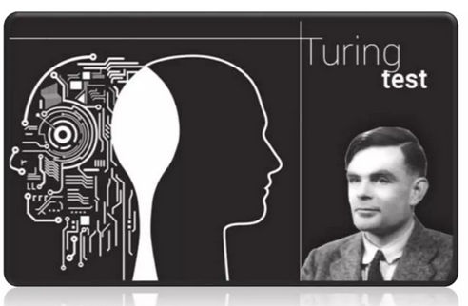
Early History
In 1950 English Mathematician Alan Turing wrote a landmark paper titles “Computer Machinery and Intelligence “ that asked the question “Can machine think”
Further work came out of a 1956 workshop at Dartmouth sponsored by John Mc Carthy, In in the proposal for that work shop, he coined the phrase a “study of Artificial Intelligence”

Slide 15
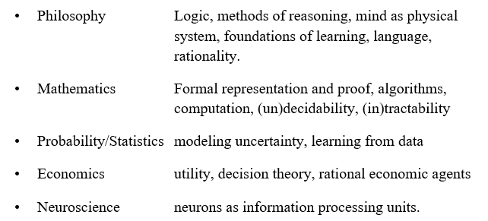
Academic Disciplines relevant to AI

Slide 16
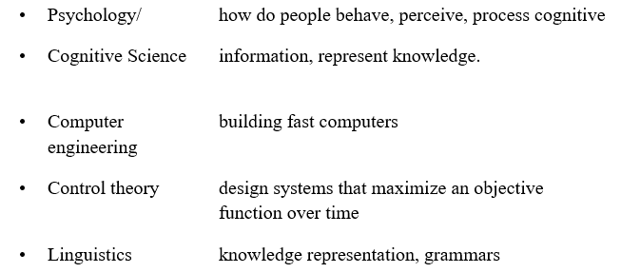
Academic Disciplines relevant to AI

Slide 17
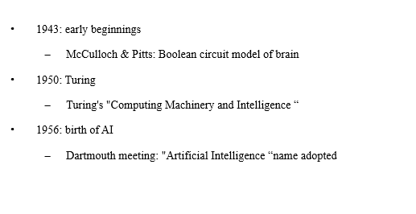
History of AI

Slide 18
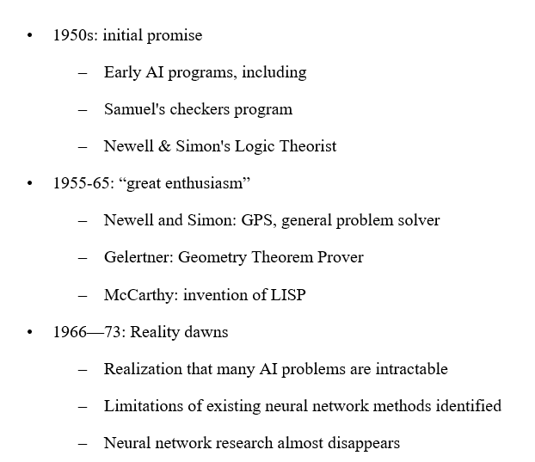
History of AI

Slide 19
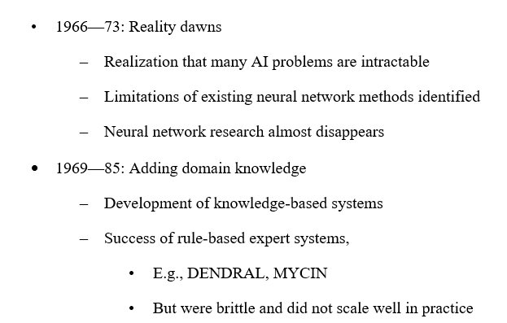
History of AI

Slide 20
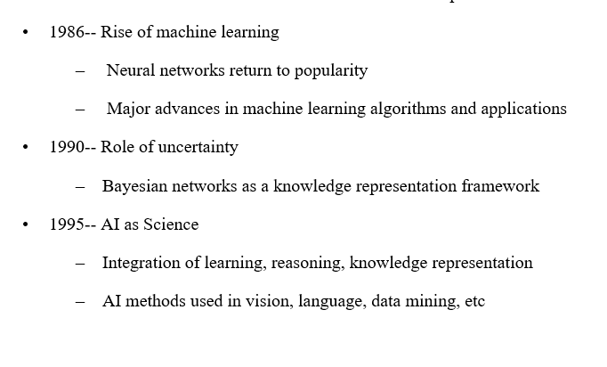
History of AI

Slide 21
History of AI

Slide 22
Successes Stories
Deep Blue defeated the world chess champion Garry Kasparov in 1997
AI program proved a mathematical conjecture (Robbins conjecture) unsolved for decades
During the 1991 Gulf War, US forces deployed an AI logistics planning and scheduling program that involved up to 50,000 vehicles, cargo, and people
NASA's on-board autonomous planning program controlled the scheduling of operations for a spacecraft
Proverb solves crossword puzzles better than most humans
Robot driving: DARPA grand challenge 2003-2007
2006: face recognition software available in consumer cameras

Slide 23
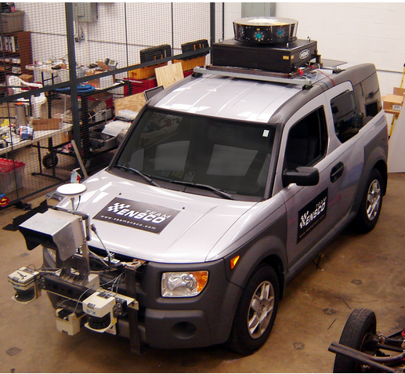
DARPA grand challenge 2003-2007

Slide 24
Example of DARPA Grand Challenge
Grand Challenge
  Cash prizes ($1 to $2 million) offered to first robots to complete a long course completely unassisted
  Stimulates research in vision, robotics, planning, machine learning, reasoning, etc
2004 Grand Challenge:
  150 mile route in Nevada desert
  Furthest any robot went was about 7 miles
  … but hardest terrain was at the beginning of the course
2005 Grand Challenge:
  132 mile race
  Narrow tunnels, winding mountain passes, etc
  Stanford 1st, CMU 2nd, both finished in about 6 hours

Slide 25
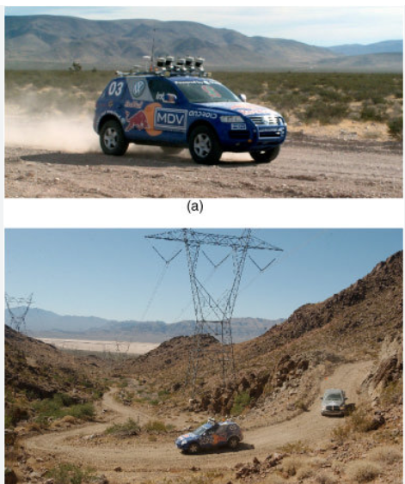
2005 DARPA Grand Challenge

Slide 26
Can we build hardware as complex as the brain?
How complicated is our brain?
  a neuron, or nerve cell, is the basic information processing unit
  estimated to be on the order of 10 ¹² neurons in a human brain
  many more synapses (10 ¹⁴) connecting these neurons
  cycle time: 10 ⁻³ seconds (1 millisecond)

Slide 27
Can we build hardware as complex as the brain?
How complex can we make computers?
  10⁸ or more transistors per CPU
  supercomputer: hundreds of CPUs, 10¹² bits of RAM
  cycle times: order of 10 ⁻ ⁹ seconds

Slide 28
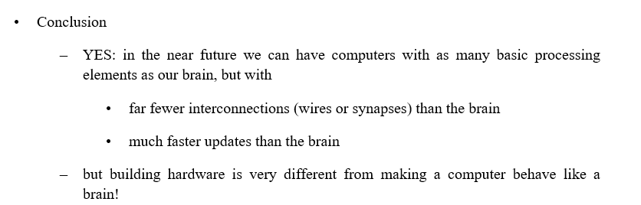
Can we build hardware as complex as the brain?

Slide 29
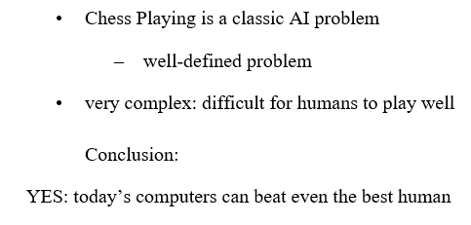
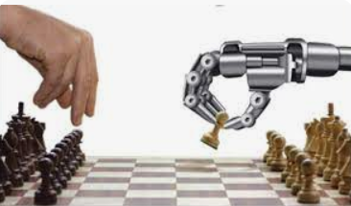
Can Computers beat Humans at Chess

Slide 30
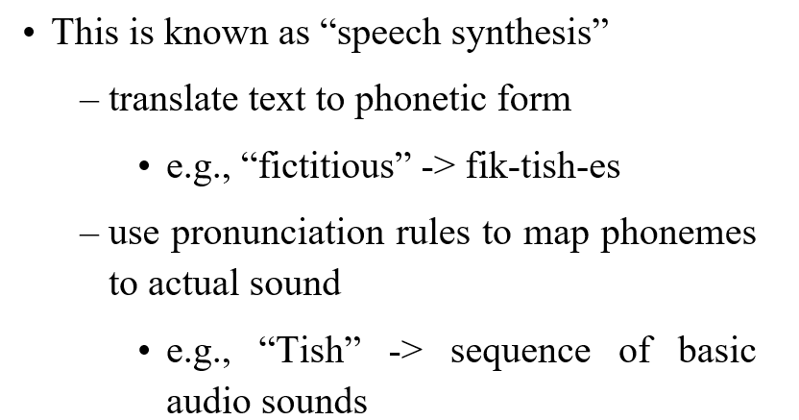
Can Computers Talk?

Slide 31
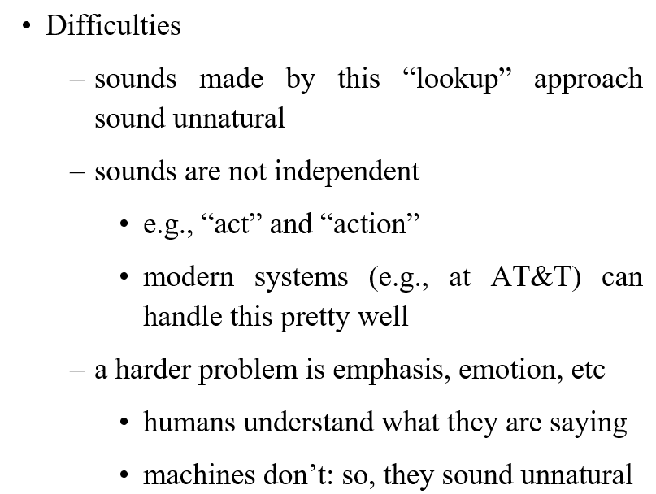
Can Computers Talk?

Slide 32
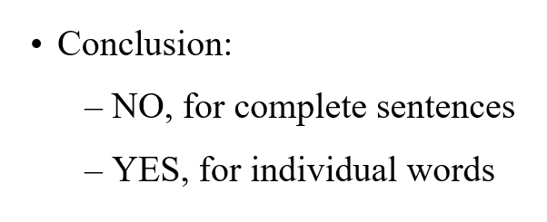
Can Computers beat Humans at Chess?

Slide 33
Can Computers beat Humans at Chess?

Slide 34
END

